Slide 1
Writing a Research Paper

Slide 2
Writing
The ability to express information in clear, concise, and understandable language
The ability to interpret and use information communicated by others.
This ability is highly marketable in today’s competitive job market.
(Geffner, 2004)

Slide 3
Speaking & Writing
You speak because you have
Something to say: a subject/topic
A reason for saying it: a purpose
Someone to listen: an audience
Notes:
When you speak, you can usually see and hear your listeners. As they respond to you, you respond to them. You answer their question, restate ideas. You can use your voice and body to clarify your thoughts. You can raise and lower your voice. You can talk with your hands. Writing is also communicating your ideas. You can’t see your readers, so, you must anticipate their reactions. You must write clearly and concisely so your readers will understand your message. To give order to your ideas, you must write sentences and paragraphs.

Slide 4
You speak because you have
Something to say: a subject/topic
A reason for saying it: a purpose
Someone to listen: an audience

Slide 5
Communication
Good writing reflects clear thinking
Good writing reflects a clear purpose
Good writing reflects a particular audience
Good writing must have a message

Slide 6
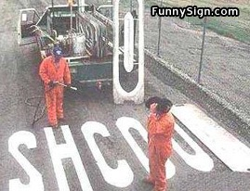

Slide 7
Purpose
Writing without a clear purpose is like driving without a destination.
You’ll get somewhere, but chances are it won’t be the right place.
Decide what you need to know about your reader to meet common communication purposes

Slide 8
You should write with a reason in mind, and you can better evaluate what is being said by determining what that reason is. Your reason for writing is also call the purpose of a selection. Three common purposes are as follows:
To Persuade
To Inform
To Entertain P I E

Slide 9
Begin to Define the Topic
Collect notes or check with teacher or other students to discuss ideas
Organize the list into a logical outline or graphic organizer
Write a thesis statement (controlling idea) for the document

Slide 10
The topic is the subject of a paragraph.
The main idea is a general idea that summarizes what most of a paragraph is about.

Slide 11
Main Idea
It is the primary point about a topic; all the other material in the paragraph fits under the main idea.
The other material is supporting details—examples, reasons, facts, and other evidence.
Notes:
Use a paragraph to find the main idea. Highlight the main idea in one color. Highlight the details in a different color. Possibly use the six pack.

Slide 12
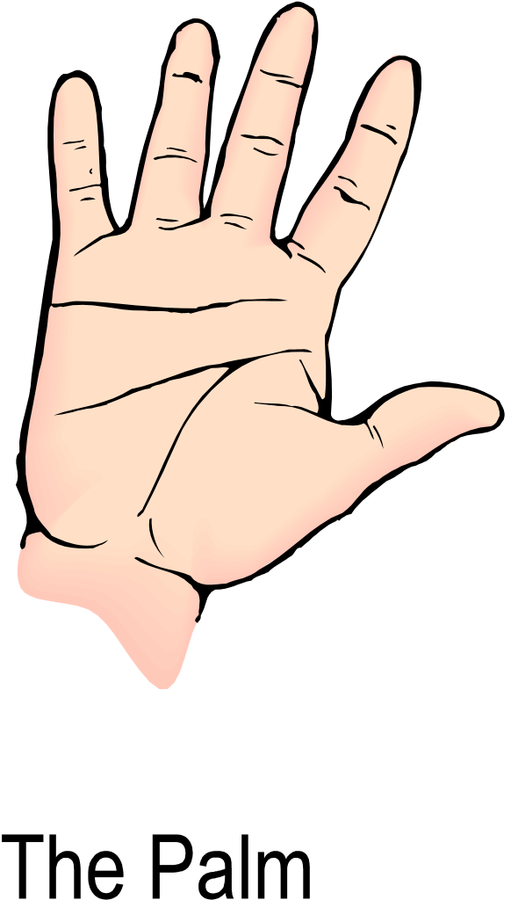
Categories for Details
R
E
F
S
N
N
D
Q
= Reasons
= Examples
=Facts
=Senses (sight, hearing, touch, smell, taste)
= Names
=Numbers (statistics)
=Definitions
=Quotations

Slide 13
Writing
Paragraph 1 is the introduction
State the thesis statement (controlling idea) in the form of a statement (Central Point)
State three main ideas that support the central point
Paragraph 2 includes the first main idea and details
Paragraph 3 includes the second idea and details
Paragraph 4 includes the third idea and details
Paragraph 5 is the conclusion
Restate the central idea in a summary statement
Review the three main ideas

Slide 14
How Should An Essay Look?
INTRODUCTION
Gives the (thesis statement) controlling idea
BODY
Major point
Major point
Major point
CONCLUSION
Summarizes or emphasizes the controlling idea

Slide 15
Analysis of a Paper
Employers are looking to hire the best employees they can find for the open positions in their companies. They are interviewing individuals with specific skills. Some of these skills are the potential employee’s ability to work with people, the employee’s critical thinking/problem solving skills, and the employee’s leadership potential. According to the latest research, as employers search for employees for their companies, they typically are looking for these particular skills in these workers.
The first skill employers look for in future employees is the ability that workers have to work with other people. Since the consumer is such an vital part of the business equation, this is a important consideration for companies in a global market.
The second skill of importance to employers is a potential employee’s ability to solve problems. In order for companies to maintain competitiveness in a global market, they must hire workers who are able to understand and deal with difficult questions, identify problems and select the best solution. Employees who are able to think differently about innovation and services will be highly sought by American companies, according to Randy Steinhoff of Quest Diagnostics. (Schramm, 2006)
Finally, employers are looking for employees who have potential leadership. They want workers who are able to influence, supervise, direct and motivate others to achieve an objective.
Employers are interested in applicants who are able to work with other people. They also want employees who have strong critical thinking skills and leadership potential. Candidates who have these skills will find themselves highly in demand in the workforce.

Slide 16
Analysis of a Paper
Idea #1
Thesis Statement
Employers are looking to hire the best employees they can find for the open positions in their companies. They are interviewing individuals with specific skills. Some of these skills are the potential employee’s ability to work with other people, the employee’s critical thinking/problem solving skills, and the employee’s leadership potential. According to the latest research, as employers search for employees for their companies, they typically are looking for these particular skills in these workers.
The first skill employers look for in future employees is the ability that workers have to work with other people. Since the consumer is such an vital part of the business equation, this is a important consideration for companies in a global market.
The second skill of importance to employers is a potential employee’s ability to solve problems. In order for companies to maintain competitiveness in a global market, they must hire workers who are able to understand and deal with difficult questions, identify problems and select the best solution. Employees who are able to think differently about innovation and services will be highly sought by American companies, according to Randy Steinhoff of Quest Diagnostics. (Schramm, 2006)
Finally, employers are looking for employees who have potential leadership. They want workers who are able to influence, supervise, direct and motivate others to achieve an objective.
Employers are interested in applicants who are able to work with other people. They also want employees who have strong critical thinking skills and leadership potential. Candidates who have these skills will find themselves highly in demand in the workforce.
Idea
#2
Idea
#3
In text citation in APA format

Slide 17
References (APA format)
Schramm, J.J. (2006). Desirable Attributes of Employees. Houston Chronicle, p.A24.
Retrieved January 31, 2009 from online DNEW database.

Slide 18
Strategy Instruction
POWER Writing Strategy
Plan -- Predict who will read this. List the title, main ideas, and details.
Organize-- Decide which main idea to write about first, second, etc. & note order. For each main idea, note the order for presenting the details. Make sure the orders are logical.
Write -- Introduce the topic and main ideas in the first paragraph. Use cues to signal ideas. Write about each main idea in the following paragraphs: explain with details.
Edit -- Read if out loud to someone. Conference with a peer for feedback. Check to see if each sentence makes sense and if it's complete. Check for spelling and punctuation errors. Revise -- Copy your paper over neatly. Check to see if the overall paper makes sense. Check once again for errors.
Notes:
Technical writers need to have a plan. This POWER strategy is a simple plan to help reluctant writers put their ideas on paper.

Slide 19
Sports
Pro amateur watching playing indoor outdoor good exercise
Playing Sports
Tennis baseball basketball track/field swimming golf soccer
Tennis
Scoring doubles indoor/outdoor equipment benefits surfaces
Tennis Equipment
Clothing courts shoes balls rackets nets equipment bags
Topic for essay: Compare/contrast the types of tennis courts
Notes:
Try this with the boss topic. Boss

Slide 20
How to Narrow a Topic
Write the general or broad topic at the top of a piece of paper
List some of the more-specific subtopics under the topic
Choose one of those topics you have listed and write it in the center of the page
Break this subtopic into more-specific subtopics
Continue this process until you have narrowed the information
Choose the specific topic that meets your needs for a particular writing assignment

Slide 21
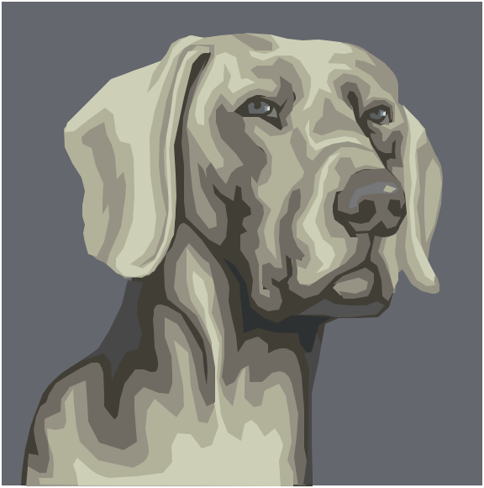
Dogs
Types history traits illnesses
Types
Working lap long/short fur good with kids
Working
Guard guide service drug film champions
Topic: Describe three kinds of working dogs.
Notes:
Instruct participants to work in groups to narrow the topic of dogs.

Slide 22
That’s all!

Slide 23
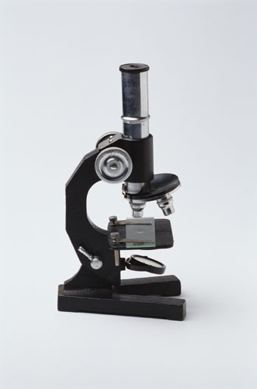
Documenting Sources: Using APA Format
A workshop brought to you by the Purdue University Writing Lab
Purdue University Writing Lab
Notes:
Rationale: Welcome to “Documenting Sources: Using APA Format.” This presentation is designed to introduce your students to the purposes of documentation, as well as methods for effectively using parenthetical citations and a reference page. The twenty-three slides presented here are designed to aid the facilitator in an interactive presentation of strategies for using APA style. This presentation is ideal for the beginning of a research unit in a science course or any assignment that requires APA documentation.
This presentation may be supplemented with OWL handouts, including “Using APA Format.” (http://owl.english.purdue.edu/handouts/research/r_apa.html), “Paraphrase: Write It in Your Own Words” (http://owl.english.purdue.edu/handouts/research/r_paraphr.html), “Quoting, Paraphrasing, and Summarizing” (http://owl.english.purdue.edu/handouts/research/r_quotprsum.html), and “Avoiding Plagiarism” (http://owl.english.purdue.edu/handouts/research/r_plagiar.html).
Directions: Each slide is activated by a single mouse click, unless otherwise noted in bold at the bottom of each notes page.
Writer and Designer: Jennifer Liethen Kunka
Contributors: Muriel Harris, Karen Bishop, Bryan Kopp, Matthew Mooney, David Neyhart, and Andrew Kunka
Developed with resources courtesy of the Purdue University Writing Lab
Grant funding courtesy of the Multimedia Instructional Development Center at Purdue University
© Copyright Purdue University, 2000
Updated September 2001 by Geoff Stacks

Slide 24
Communication

Slide 25
The Bug
Notes:
Hand out directions for drawing the bug.

Slide 26
The Shape
Choose a partner
Agree on a shape
Write down the steps for someone to draw the shape
Write your names on the back of the directions
Pass the directions to another group (airplane)
Try to draw the shape from the written directions
Check the shape with the authors’ of the directions

